Slide 1

Major Project –Final Viva –Voce Master of Computer Applications VI Semester – 2022
School of Computer Science and Applications

Slide 2
A PROJECT REPORT ON AN Air Pollution forecasting using LSTM and GRU
Submitted Final Viva –Voce Project report completion of MCA degree
Presented by:
Mr. Davada Juned Aslam
SRN: R20SCS06
Internal Guide : Dr. Hemant K S

Slide 3
Agenda
Introduction
Software hardware Requirement
Existing system and Proposed system
Methodology
Implementation
Result
Conclusion

Slide 4
Introduction
With the development of industry In last few years , we have to comprise with the air quality quite a lot. Even though we are not getting the air quality as good as earlier.
The Air pollution is a mixture of hazardous substance from both human and natural resources.
Vehicle emissions, fuel oils and natural gas to heat homes, by-products of manufacturing and power generation, particularly coal-fueled power plants, and fumes from chemical production are the primary sources of human-made air pollution.
Because of this polluted air quality many people are getting infected and getting a harmful disease like lung cancer and many more.
To control this air pollution we have to take care of many things like what will be the dew on that day , what will be the temperature on that day , what will be the air pressure and many more like that.
The Dew point is the temperature the air needs to be cooled to in order to achieve the relative Humidity.
Due to the air pollution even global warming is affecting.

Slide 5
Cont..
The air pollution could not just affect the human being it can affect the plant ecosystem also and it can even destroy the plant.
The air pollution depends upon the different parameters like the if the snow is there on that day then the Pollution will remain low on that day. And if there is no rain or no snow on that day then the pollution will be high on that day.
Other parameters like if the wind speed is more that the pollution on that area will remain low.
The pollution will be high if there is no rain , no snow and even there is very low wind speed in that area and the temperature is high.
The pollution can very from hour to hour so we have collected the every hour of data with all the parameters.
We are going to develop the model which can forecast the Air pollution based on the previous data using RNN(Recurrent Neural Network) algorithms which are LSTM(Long-short term memory) and GRU(Gated Recurrent Unit).

Slide 6
Software and hardware requirement
Operating System : Windows 10
Software requirement : Python3 , sklearn , tensorflow , pandas , numpy
Hardware requirement : 8gb ram , 120gb storage

Slide 7
Existing system and proposed system
In real time there are the website and some weather app , which are showing the real time Air pollution index on the basis of sensor the data which they have collected.
In real time there are no any website which can forecast the air pollution they are just giving us the data which they have collected using the different sensors over there in atmosphere.
But for our model we don’t need any real time data instead of that we can just use the existing data which they have collected and we can forecast on the basis of that.
The proposed project is that we just have to give the last 15 days of data and based on that it will forecast the Air pollution based on that. We have to give the data based on this parameters like Dew , temperature , pressure , wind_Dir , wind_speed , snow , rain and pollution.

Slide 8
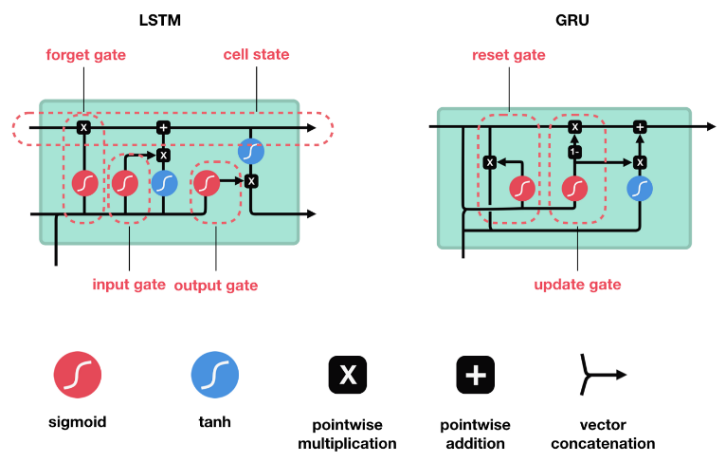
Methodology
In this research we are going to use the famous Recurrent Neural Network algorithm which are LSTM(Long Short term memory) and GRU(Gated Recurrent Unit).

Slide 9
Cont…
We have created a model based on the both the LSTM and GRU. We have added the different layers of LSTM and GRU to it to run it.
The model is quite accurate while forecasting the data for the air pollution.
We have added some layers for the Dropout which will drop out the some of the neurons which are not useful or the neurons which are not sending the data to the next layer.
The optimizer we have used is Adam optimizer with the learning rate of 0.001.
Based on this parameter we have trained the model with the 200 epoch value and 25 step per epoch value.

Slide 10
Implementation
For implementing this project we have used LSTM and GRU model for the dataset. We have trained that model based on all the 3 epoch values which are 100,200 and 300 for all the models. For all the model we have trained separately and saved the model.
Firstly we have to understand the dataset. We will get the information for all the columns and understand the data what we have in that column.
For understanding the dataset we have plotted the co-relation graph

Slide 11
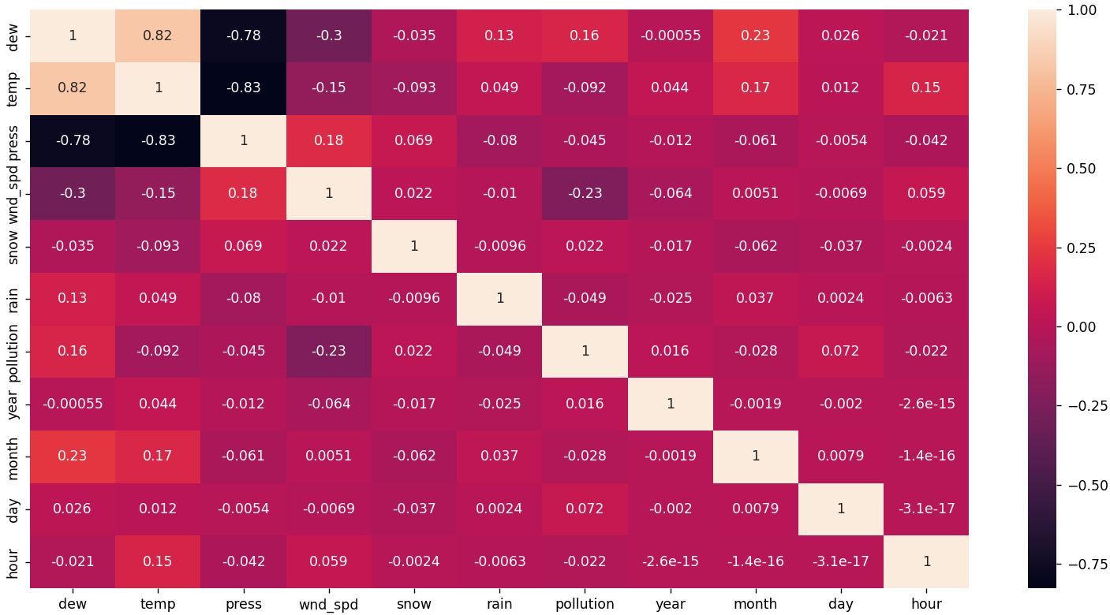

Slide 12
Cont..
We have trained both the model for LSTM and GRU with all the 3 epoch values 100, 200 and 300. The model which are the created has generated the graphs from which we can precise the model accuracy. Which model are performing well on that dataset.
We have trained the model according to that we have to give last 15 days of data and it will predict next 24 hours of data. And for the creating a model we have to used the 50 neurons for each layer and trained the model based on that.
For each model we have used the dropout layer and activation layer of tanh and sigmoid and also used the dense layer for generating the output.

Slide 13
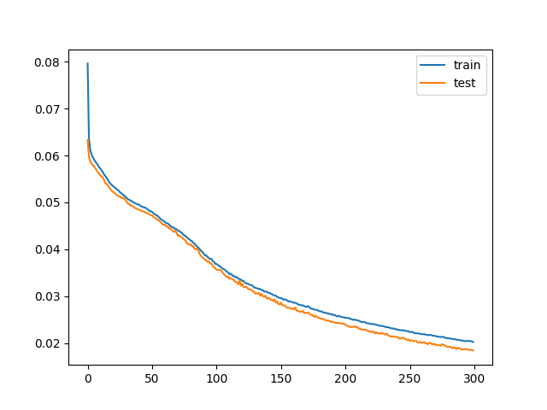
Result
The firstly we have trained the model based on the GRU model with 300 epoch and 50 neurons in each layer and it will generate the model accuracy graph for the model.

Slide 14
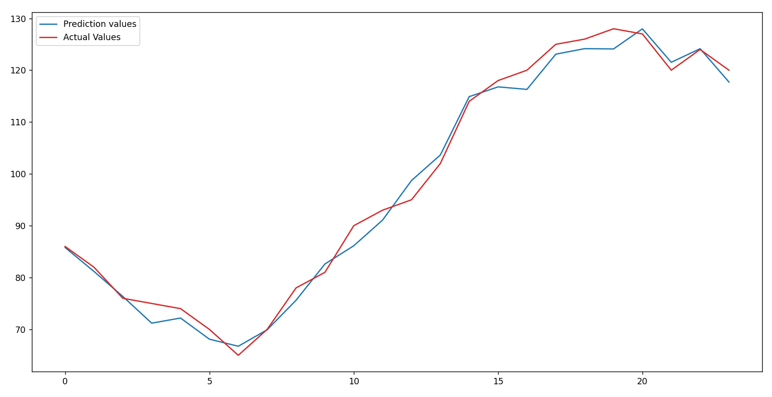
Cont..
The model has generated the output based on the last 15 days of data and it will generate the output for the next 24 hours of data and it will generate the graph. With the accuracy score of 91.0987%.

Slide 15
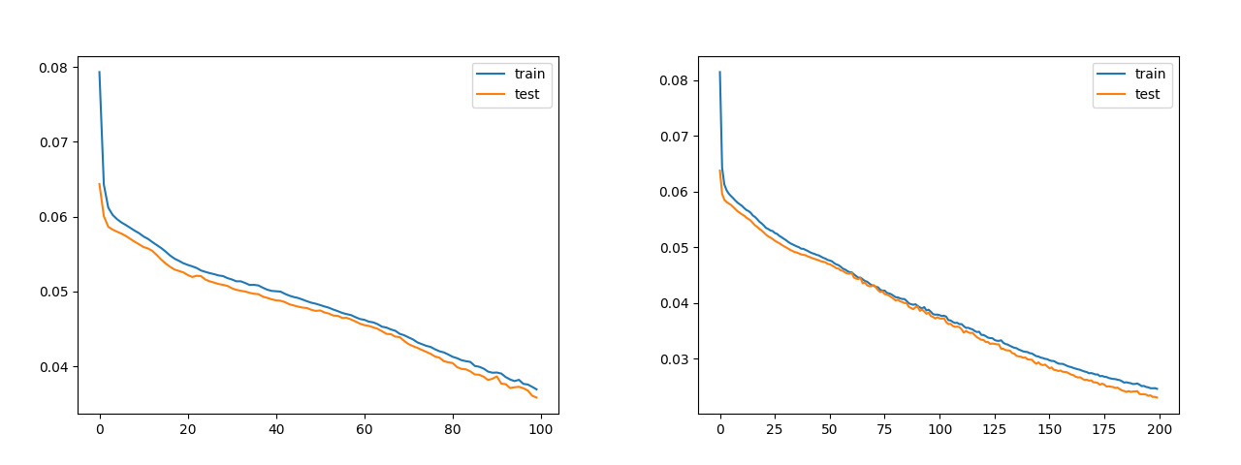
Cont..
We have trained the model based on the 100 and 200 epoch values for the GRU model. And generate the graphs for that.

Slide 16
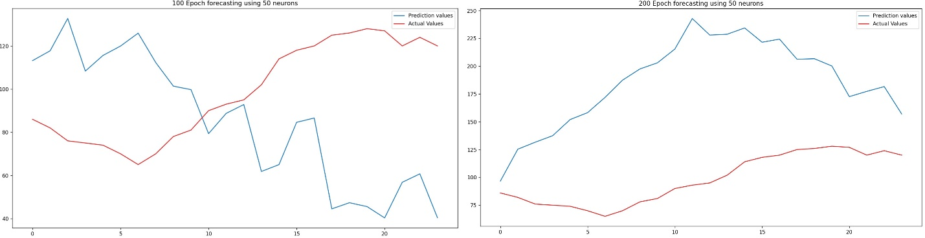
Cont..
Based on the saved model we have done the prediction for the dataset for the next 24 hours of data. And generated accuracy score for the 44.0876% and 68.956%.

Slide 17
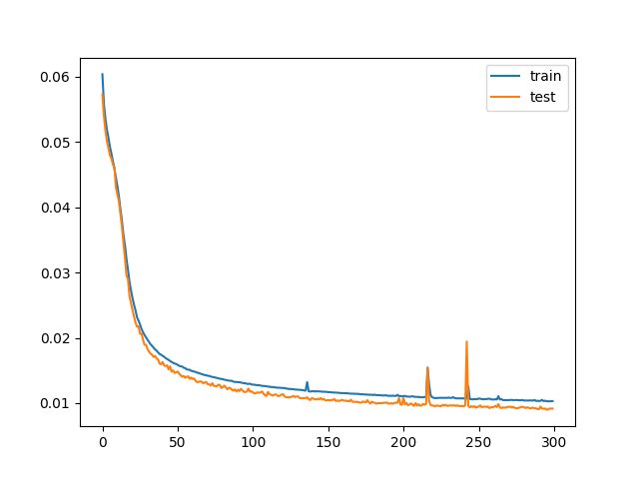
Cont…
For the LSTM also same like as GRU we have trained the model based on the 3 epoch values which are 100, 200 and 300 epoch values.
Firstly we have trained the model we have used 300 epoch and 50 neurons values and generating model accuracy graph for model.

Slide 18
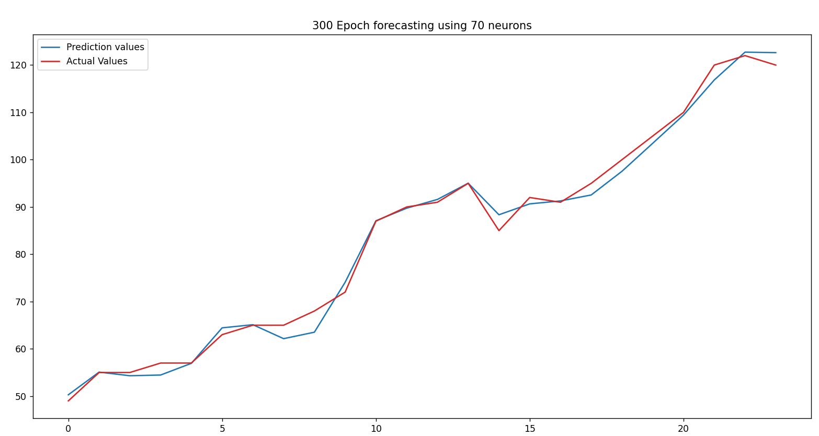
Cont..
The model has generated the output based on the last 15 days of data and it will generate the output for the next 24 hours of data and it will generate the graph. With the accuracy score of 92. 876%.

Slide 19
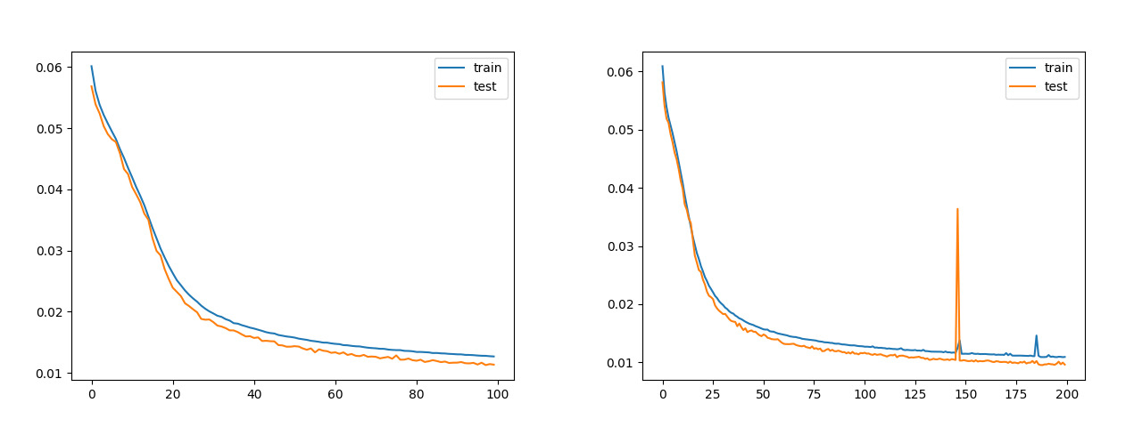
Cont..
We have trained the model based on the 100 and 200 epoch values for the GRU model. And generate the graphs for that.

Slide 20
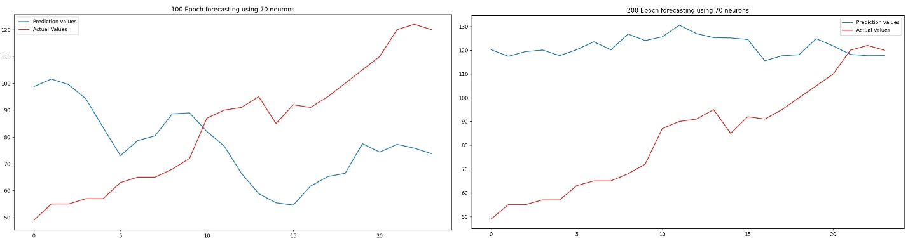
Cont..
Based on the saved model we have done the prediction for the dataset for the next 24 hours of data. And generated accuracy score for the 49.7098% and 72.476%.

Slide 21
Conclusion
The project which we have created will forecast the air pollution data based on the previous days data on the hourly basis. The model is quite accurate while forecasting the data for the air pollution.
The model will take the last 15 days of data on hourly basis and predict the next 24 hour of data.
But we can forecast the weather how it is now and what in the next hour we cannot say anything about whether. The model will just forecast the next 24 hours of data based on the data which we have given for the forecasting.

Slide 22
Thank You

Slide 23







Icons
Architecture
Commerce
Legal Studies
Arts & Humanities
Performing Arts
Management Studies
Science & Tech
Engineering

